Slide 1


Slide 2
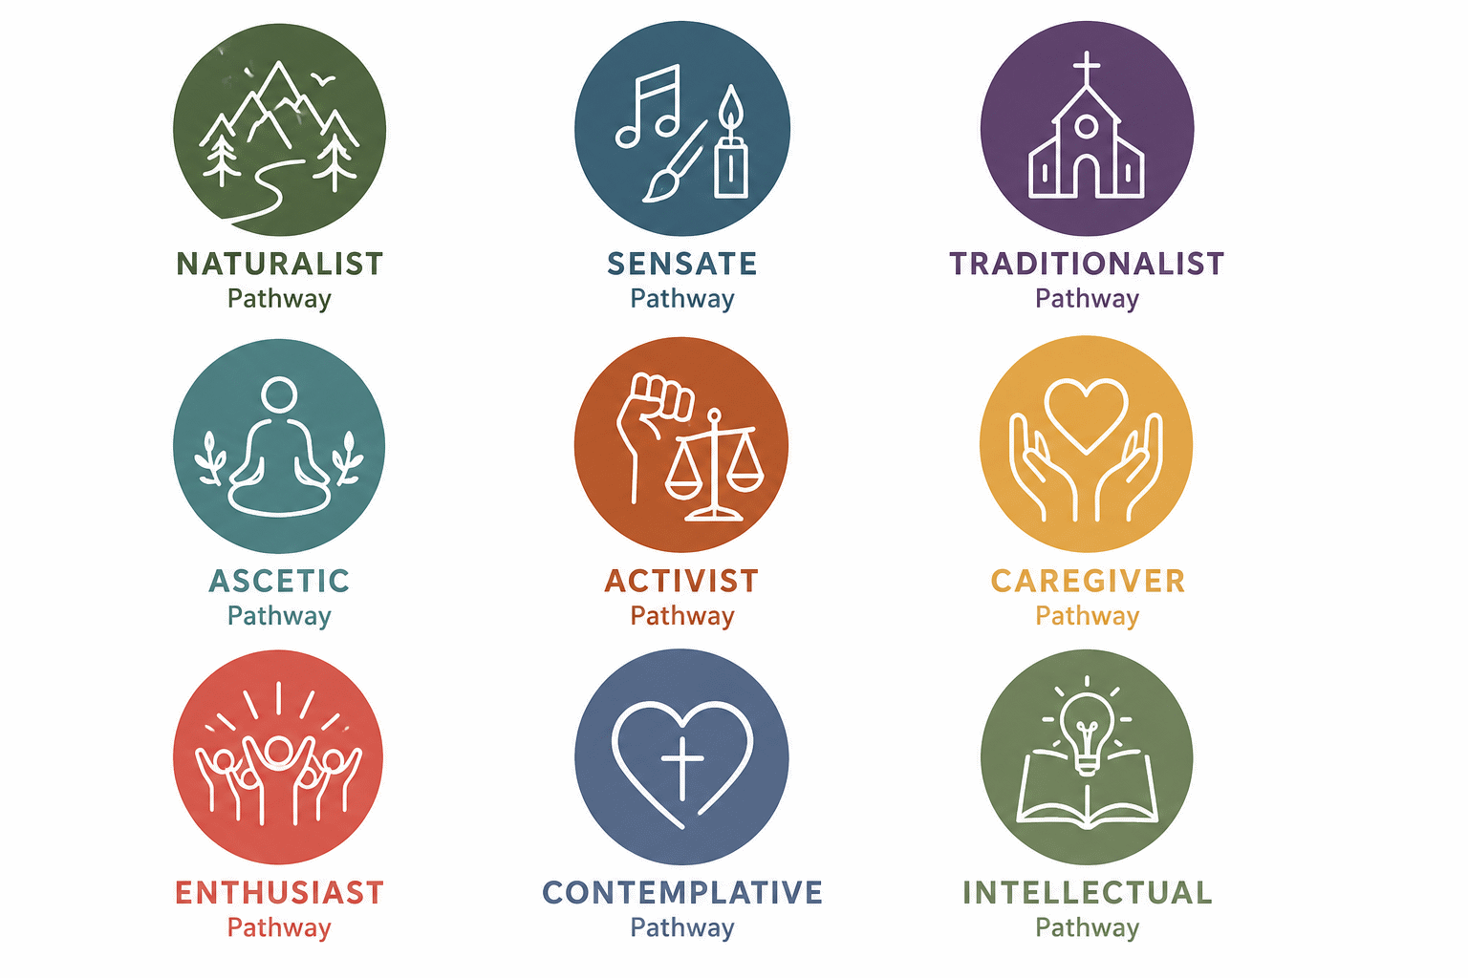

Slide 3

Connect with God
Through Creation
Psalm 19:1
"The heavens declare the glory of God;
the skies proclaim the work of his hands.“
Person King David

Slide 4

Experience God
Through the Senses
Exodus 31:1-5
“…to make artistic designs for work in gold, silver and bronze, to cut and set stones, to work in wood, and to engage in all kinds of crafts.”
Person Bezalel

Slide 5

Connect with God
Through Ritual & Structure
Deuteronomy 6:4-6
“…Tie them as symbols on your hands and bind them on your foreheads.”
Person Ezra

Slide 6

Encounter God Through Solitude & Simplicity
Mark 1:35
“Very early in the morning, while it was still dark, Jesus got up, left the house and went off to a solitary place, where he prayed.”
Person Elijah

Slide 7

Experience God Fighting for Righteousness
Micah 6:8
“…To act justly
and to love mercy
and to walk humbly
with your God.”
Person Nathan

Slide 8

Connect with God Through Caring for Others
Matthew 25:40
“Truly I tell you, whatever you did for one of the least of these brothers and sisters of mine, you did for me.”
Person Dorcas

Slide 9

Connect with God Through Worship & Celebration
Psalm 100:1-2
“Shout for joy to the Lord, all the earth. Worship the Lord with gladness; come before him with joyful songs.”
Person Miriam

Slide 10

Connect with God Through Intimacy & Prayer
Luke 10:29-42
“She had a sister called Mary, who sat at the Lord’s feet listening to what he said.”
Person Mary of Bethany

Slide 11

Connect with God Through Truth & Understanding
Matthew 22:37
“Love the Lord your God with all your heart and with all your soul and with all your mind.”
Person Paul

Slide 12

We need each other.

Slide 13
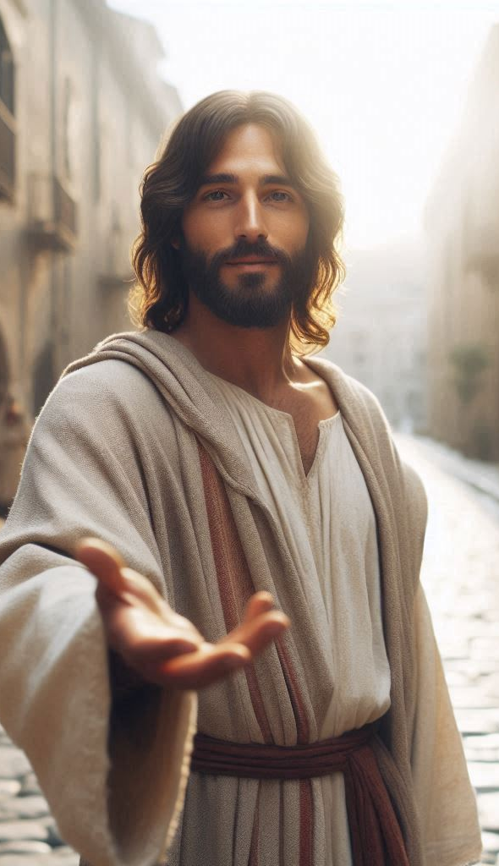
Which ways do you
encounter Jesus?

Slide 14
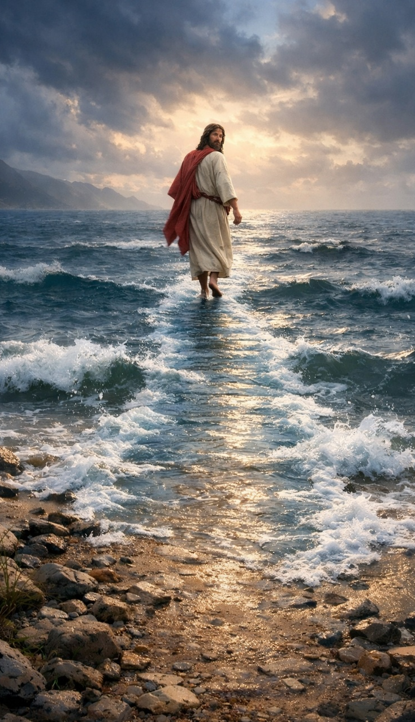
Walk your Pathway?

